Slide 2
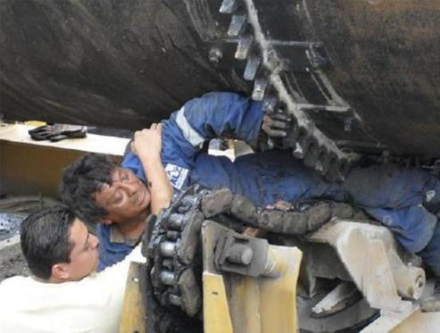
EDUCATE YOUR WORKERS
One second or less can change a life and the lives of many, forever.
There is only one winner when an accident happens.
c
I Thought it Was Stopped!
It Happened So Fast!
WINNER = MACHINE
STAY AWAY – STAY SAFE

Slide 3
TO THE POINT WITHOUT A PINCH: THE RIGHT WAY TO GUARD
The point of this presentation is to:
Aid in identifying the equipment in your facilities that require guarding
Demonstrate the hazardous areas around that equipment
Learn how to compliantly Guard that equipment with fixed guarding

Slide 4
WHY DO WE NEED GUARDING?
OSHA Regulations & Identifying the Hazards
Any machine part, function, or process which may cause injury must be safeguarded. When the operation of a machine or accidental contact with it can injure the operator or others in the vicinity, the hazards must be either controlled or eliminated.
STAY AWAY – STAY SAFE

Slide 5
SAFETY HAZARDS AND WHAT CREATES THEM?
The Point of Operation - the point or location where work is performed on material or where the stock or material is fed into the machine
The Power Transmission Devices – such as flywheels, pulleys, belts, connecting rods, couplings, cams, spindles, chains, cranks and gears.
All Moving Parts - all parts which move while machine is working. Including reciprocating, rotating, and transverse moving parts, feed mechanisms etc.
Please note that this presentation is focused on fixed guarding,
so only the latter two mechanical hazards and how to guard them will be discussed.
STAY AWAY – STAY SAFE

Slide 6
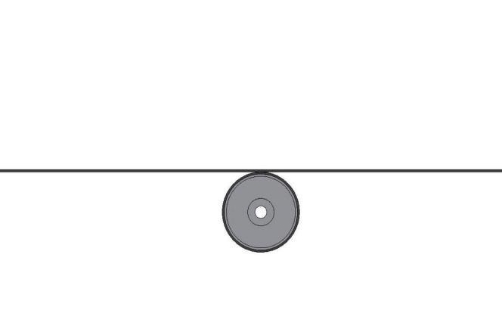
NOT JUST THE IN-RUNNING PINCH POINT
Pinch Point
DIRECTION OF BELT TRAVEL
On Belt Conveyors the in-running pinch point is the area where the belt and roller make contact on the in-feed side.
STAY AWAY – STAY SAFE
Notes:
6

Slide 7
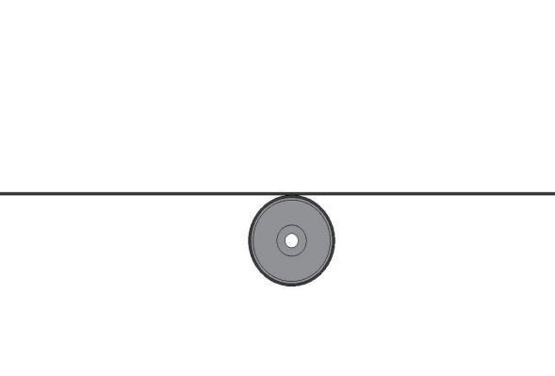
DISTANCE FROM DANGER AREA
DANGER ZONE KEEP 36” AWAY
36 Inches
36 Inches
36 Inches
STAY AWAY – STAY SAFE
Notes:
7

Slide 8
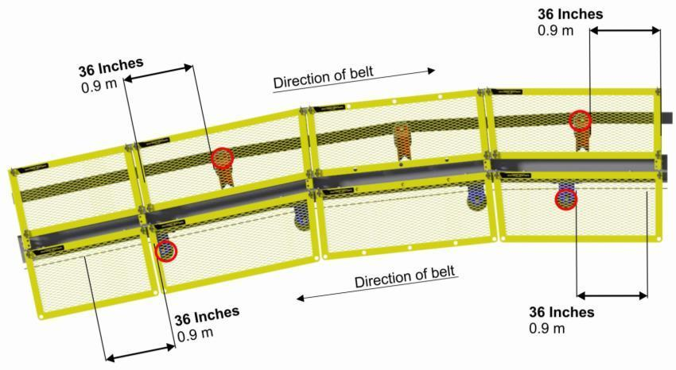
CONVEYOR BENDS
The conveyor bend causes pinch points at the return rollers.
The guard is required to be at 36” in all directions from the pinch point and these return rollers are close together,
therefore in this example the guarding is required along the complete conveyor
STAY AWAY – STAY SAFE

Slide 9
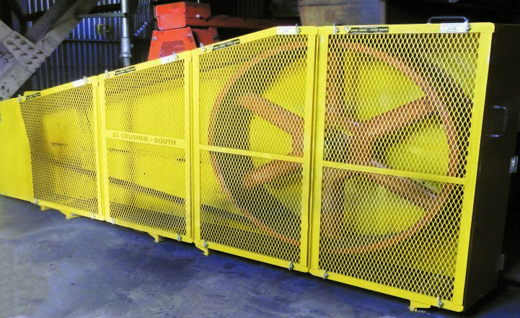
FIXED GUARDING
Fixed Guarding refers to a guard that is a physical barrier between a worker and a danger zone
and it requires a “tool to remove.”
STAY AWAY – STAY SAFE

Slide 10
Principles of Fixed Guarding
There several key points that should always be considered when designing and fitting guards:
The guard should be considered a permanent part of the machine
The guard must make access to all moving parts and nip points physically impossible
The guard should be installed as close to the machine part as possible while still being compliant, be secure, tamper-resistant and durable
The guard must not impede the operation of the plant, and should be designed for the specific job and equipment
The guard itself must not create a new hazard or manual handling risk
The guard must ensure that no object will fall into the moving parts
The guard can only be removed with a tool
The guard must allow for safe lubrication and maintenance
STAY AWAY – STAY SAFE

Slide 11
YOUR FIRST LINE OF DEFENCE
A physical barrier (fixed guarding) is a means of physically preventing access to dangerous areas.
It is a requirement by law!
STAY AWAY – STAY SAFE

Slide 12
COMMON AREAS REQUIRING GUARDING
CONVEYOR HIGH RISK ZONE AREAS
Tail pulley
Head pulley
Gravity take-ups and counterweights
Snubber pulleys
Additional drive pulleys
V-belt or chain drives
Transfer or load-out points
Skirt boards
Return idlers
Troughing idlers that have obstructions (i.e. ladders)
Conveyor bends
Tripper conveyor
Bearing/Rotating shafts
Couplings
STAY AWAY – STAY SAFE

Slide 13
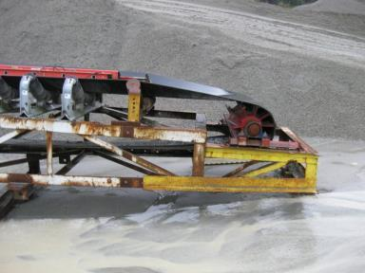
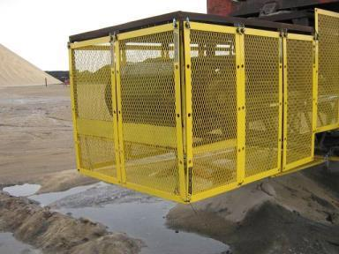
TAIL PULLEYS
Tail pulley guards should be designed to prevent any contact with:
The pinch point between the pulley and the belt
The exposed pulley and the pulley face
The exposed shaft and bearing
STAY AWAY – STAY SAFE

Slide 14
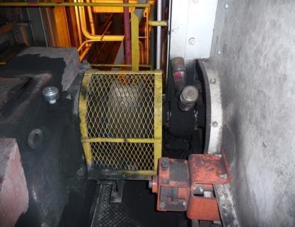
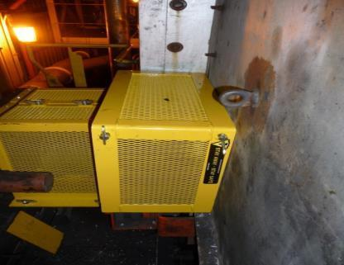
COUPLINGS
- Exposed shaft & pulley
- Mesh is too large to restrict contact with rotating parts.
- Fully enclosed coupling combined with a Bearing Guard.

Slide 15
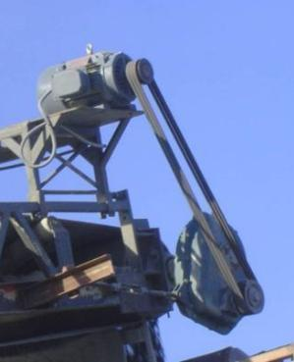
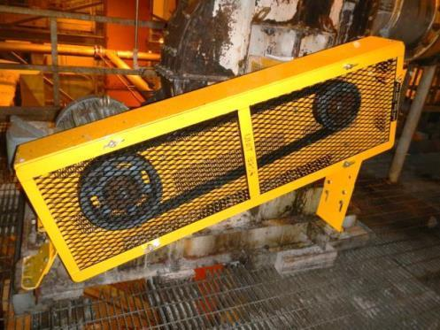
V-BELTS
c
c
V-BELT (Belt Exposed)
V-BELT (Belt Guarded)
Which situation looks safer to you?
STAY AWAY – STAY SAFE

Slide 16
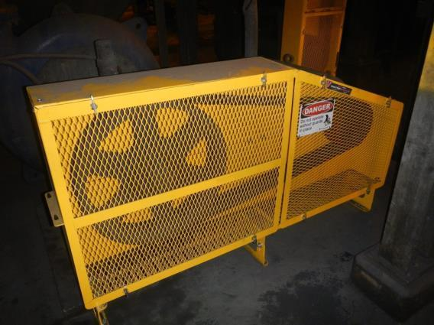
PUMP GUARD
c
STAY AWAY – STAY SAFE

Slide 17
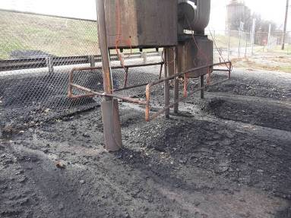
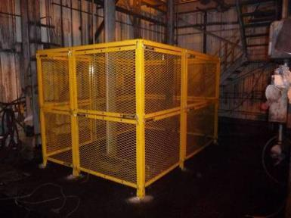
COUNTER WEIGHT
Unguarded
Guarded
STAY AWAY – STAY SAFE

Slide 18
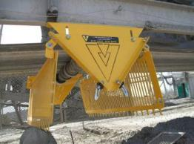
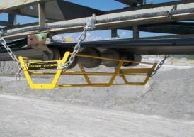
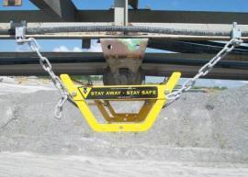
IDLERS
Idlers will need to be guarded to stop someone from making contact or from it potentially falling onto someone.
A pinch point guard is required if a return idler is less than 7-ft away from walking or working surfaces.
c
c
Idler baskets are required for any return rollers that are above 7-ft from the ground. Their primary duty is to catch the roller in case of failure and stop it from falling onto someone that may be walking or driving below at the time.
c
c
STAY AWAY – STAY SAFE
Notes:
***** CLICK SLIDE *****

Slide 19
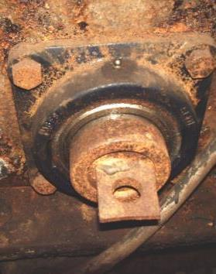
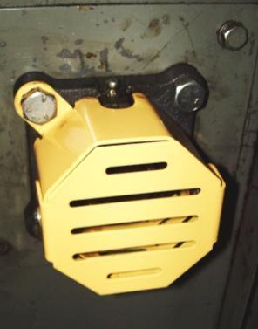
FLANGE BEARING
c
c
The photo on the left shows an unprotected flange bearing.
Although this shaft may rotate at a slow rate, if a worker were to get entangled, there’s no stopping it.
The photo on the right shows a properly guarded flange bearing. It is designed in such a way as to allow the greasing of the bearing without removal.
STAY AWAY – STAY SAFE

Slide 20
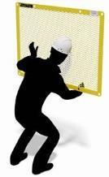
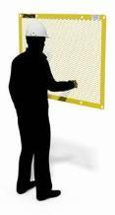
A U T O
The guarding should take into account the physical characteristics of the people involved and, in particular, their abilities to reach through openings and over or around barriers or guards.
WHEN YOU ARE GUARDING EQUIPMENT YOU MUST NOT BE ABLE TO REACH THE HAZARD FROM
Around
Under
Through
Over
c
c
c
c
STAY AWAY – STAY SAFE

Slide 21
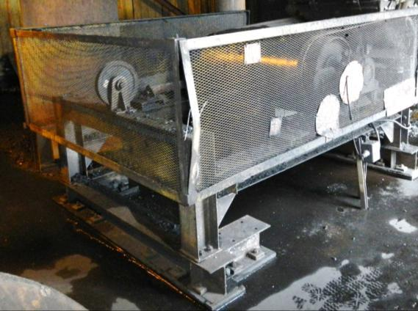
HAZARDS THAT ARE NOT RECOGNIZED
Here someone can reach AROUND the guard at the front corner, UNDER the guard from the bottom, THROUGH the guard at the front because the mesh is too close to what is being guarded and OVER the top.
A – U – T – O
c
OVER
AROUND
THROUGH
UNDER
STAY AWAY – STAY SAFE

Slide 22
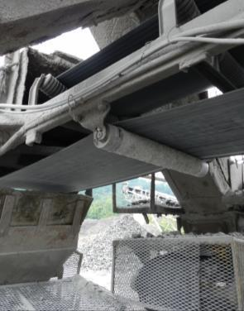
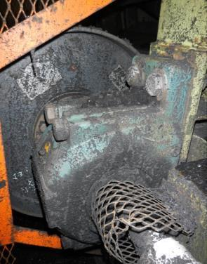
HAZARDS THAT ARE NOT RECOGNIZED
Where do you see the hazards here?
c
c
STAY AWAY – STAY SAFE

Slide 23
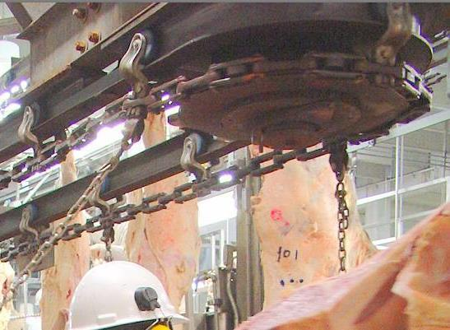
NOW, THIS IS A HAZARD!
What do you see as a guarding concern here?
c
Exposed Sprocket and Chain
More?
Rollers on a track
Rotating Parts
STAY AWAY – STAY SAFE

Slide 24
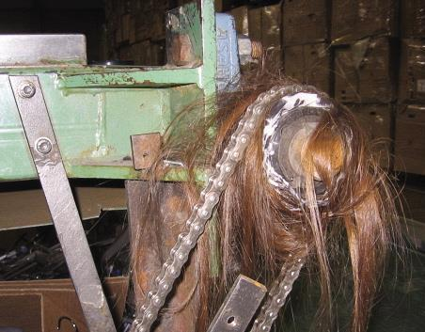
WHAT’S MISSING?
c
Hopefully after today you should never have to witness this.
It definitely required a safety guard!
STAY AWAY – STAY SAFE

Slide 25
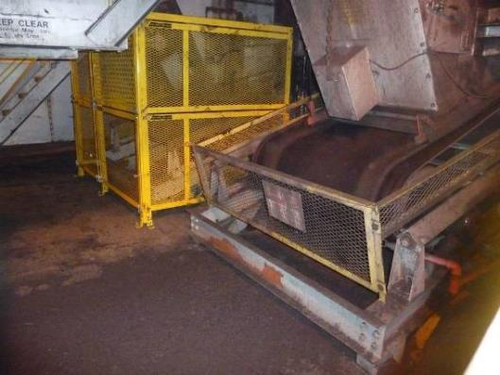
NON-COMPLIANT GUARDING VS. COMPLIANT
c
NON-COMPLIANT
COMPLIANT
NON-COMPLIANT
STAY AWAY – STAY SAFE

Slide 26
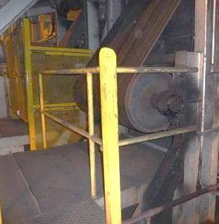
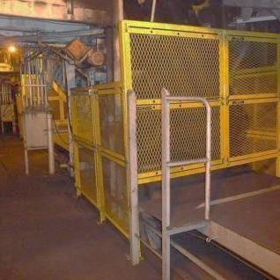
HAND RAILING VS. GUARDING
c
c
NON-COMPLIANT
COMPLIANT
STAY AWAY – STAY SAFE

Slide 27
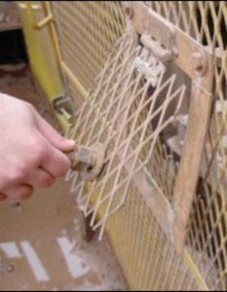
DOES YOUR GUARD CREATE A HAZARD?
c
Does the design, material and construction of the guard create a hazard?
IS IT FREE OF:
Burrs
Sharp Edges
Pinch Points
STAY AWAY – STAY SAFE

Slide 28
ASSESS YOUR EQUIPMENT FOR HAZARD RISKS
Use the following checklist to assess your equipment hazards and prioritize your action plans.
For each zone listed, assess your risk rating using the following guidelines:
A = Area is unguarded, hazardous conditions exist and guarding is required for compliance
B = Area that requires frequent maintenance or clean out and guarding needs upgrading
C = Guarding exists but should be improved for compliance
D = Not applicable or no hazards exist
Zones that were identified with an “A or B” risk rating, present imminent danger to workers in the area and need to be addressed immediately.
Zones that have a “C” risk rating should be reviewed with your Supervisors, Workers and your Joint Health & Safety Committee to determine what improvements are required and establish a reasonable time frame for completion.

Slide 29
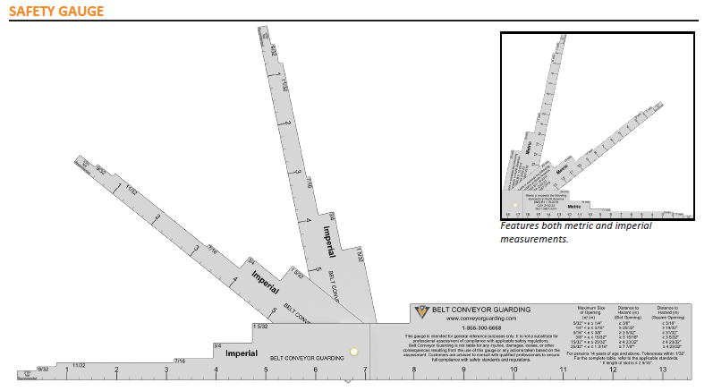
SAFETY GAUGE
The Machine Safety Gauge is a helpful tool to verify machine safety guarding compliance and ensures that workers are kept safe around rotating equipment and conveyors.
Opening size and distance requirements are outlined in
ANSI B.11.19-2019, CSA Z432:23 and ISO 13857-2019 Machine Safety and Safe Distance Standards.
STAY AWAY – STAY SAFE

Slide 30
DISTANCE FROM POINT OF OPERATION
Distance of guard from hazard according to the guard opening
MAXIMUM OPENING (INCHES) | DISTANCE FROM HAZARD (INCHES)
¼ | 25/32
⅜ | 3 5/32
⅝ | 4 23/32
1¼ | 7 28/32
1⅞ | 33 15/32
5 | Not recommended
Opening size and distance requirements are outlined in
ANSI B.11.19-2019, CSA Z432:23 and ISO 13857-2019 Machine Safety and Safe Distance Standards.
Please complete the form on our web site to receive a free safety gauge
STAY AWAY – STAY SAFE

Slide 31
ANY SPECIAL REQUIREMENTS?
Lubrication
Vibration Analysis
Heat Analysis
Speed Sensing
Corrosive Area
Flammable Area
STAY AWAY – STAY SAFE

Slide 32
ERGONOMIC & MAINTENANCE-FRIENDLY
Design your guards to be ergonomic and maintenance-friendly.
OSHA states that:
If possible, machine design should permit routine lubrication and adjustment without removal of safeguards. But when safeguards must be removed, and the machine serviced, the lockout procedure of 29 CFR 1910.147 must be adhered to.
**The maintenance and repair crew must never fail to replace the guards before the job is considered finished and the machine is released from lockout.**
STAY AWAY – STAY SAFE

Slide 33
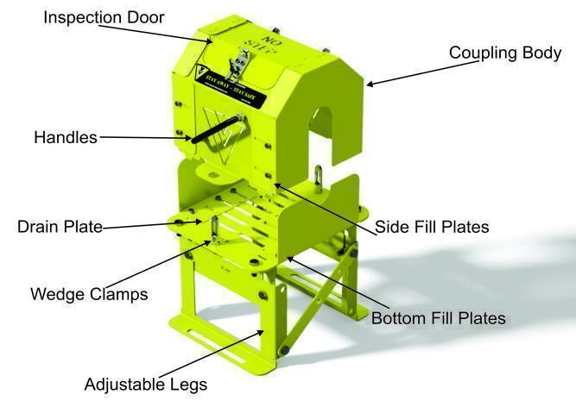
MAINTENANCE-FRIENDLY COUPLING GUARD
This shows how the modular design can be easily disassembled for maintenance.
c
STAY AWAY – STAY SAFE

Slide 34
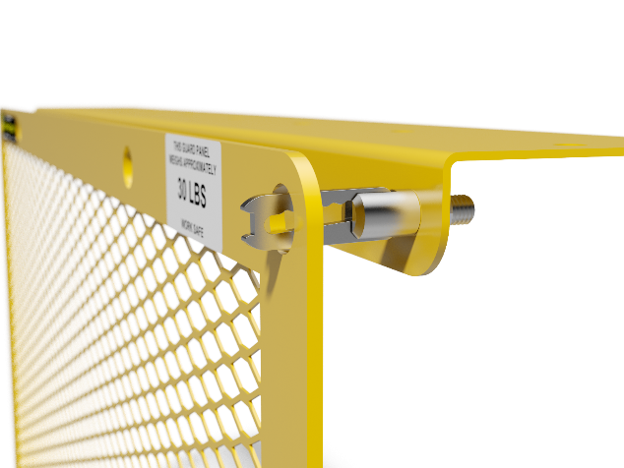
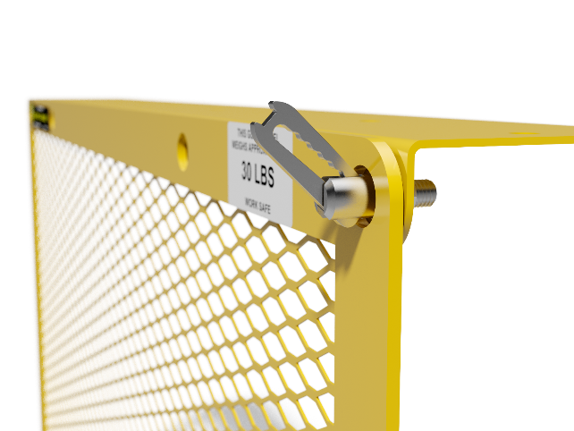
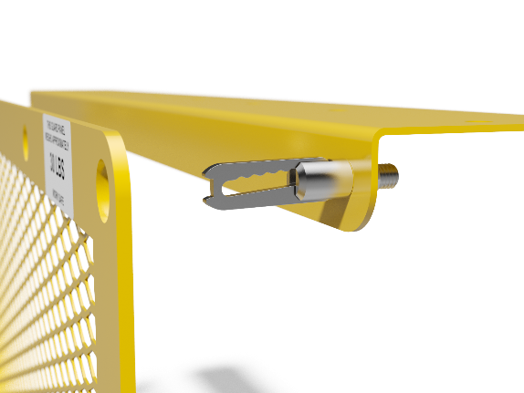
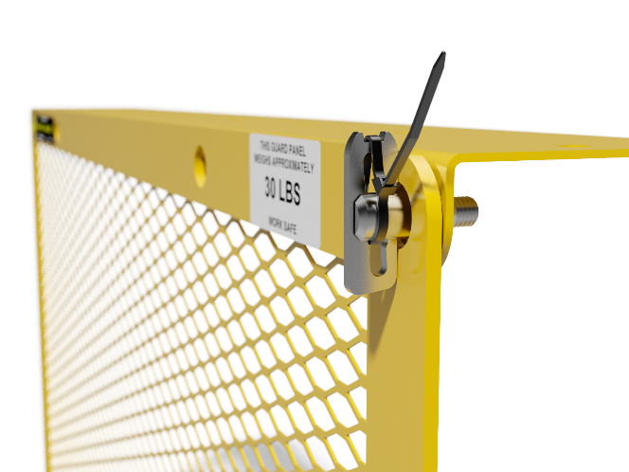
FASTENING SYSTEM
A more user friendly alternative is the Smart Wedge Clamp.
Bolts are commonly used as fastening systems but they can rust and often need replacing. Wearing gloves can make it difficult to manipulate them and they can be dropped and lost.
FULLY OPENED POSITION
PARTIALLY OPENED POSITION
PARTIALLY CLOSED POSITION
Tie Wrap to Lock:
ANSI B11 requirement for a Tool to Remove
REMEMBER TO REPLACE THE TIE WRAP
PATENT PENDING
STAY AWAY – STAY SAFE

Slide 35
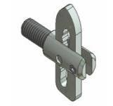
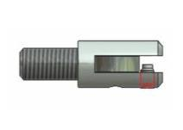
LOCKING WEDGE CLAMP
This is designed for applications where using a cable tie is not desirable.
It requires an Allen key to quickly lock or unlock the set screw.
CLOSED POSITION
In open position, set screw allows installation or removal of guards
Locking Wedge Clamp body shows built in set screw
Bird’s eye view of set screw tightened, securing the guards in place
PATENTED
STAY AWAY – STAY SAFE

Slide 36
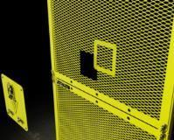
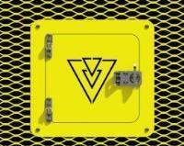
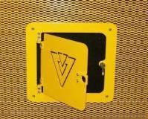
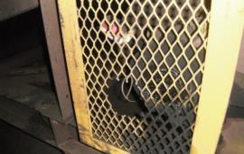
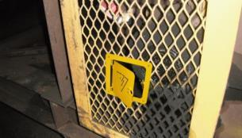
BENEFITS OF INSPECTION DOORS
Inspection Doors are necessary when you need to keep machinery running and still want to be able to inspect or access certain areas. The unique 2 piece design allows for retrofitting existing compliant guarding or installing in new.
c
c
c
c
c
HOLE CUT IN GUARD = NON-COMPLIANT
INSPECTION DOOR = COMPLIANT
STAY AWAY – STAY SAFE

Slide 37
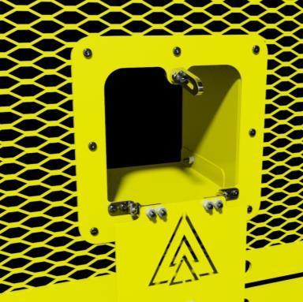
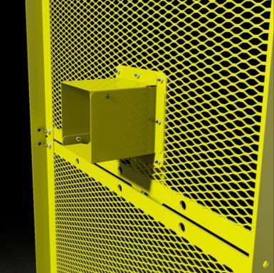
INSPECTION DOOR EXTENSIONS
This shows you the optional Inspection door extensions which are also available.
They can be customized to suite your application.
c
c
STAY AWAY – STAY SAFE

Slide 38
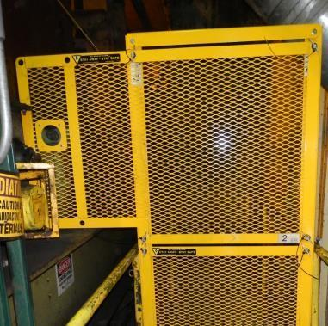
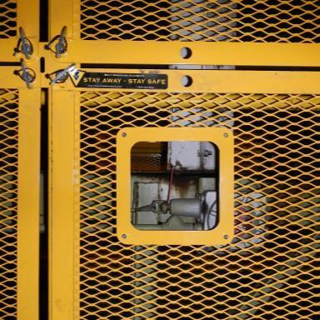
ACCESS PORTS
When you need occasional access or if you need continuous or frequent access, use an access port.
c
c
STAY AWAY – STAY SAFE

Slide 39
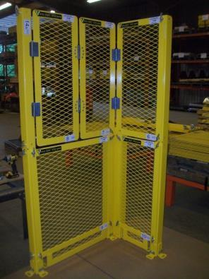
HINGED FLAT GUARDS
You may have a need for increased access at times when you are properly locked out.
Hinging certain areas of the guard will allow for easier access to the equipment for maintenance.
c
c
STAY AWAY – STAY SAFE

Slide 40
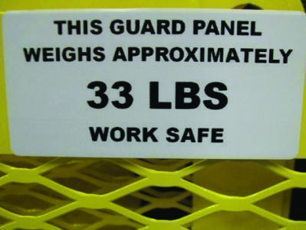
ERGONOMICS
A well designed guard should weigh less than 50 pounds.
c
A guard should not require more than one person to remove or install it.
Putting weight labels on all guards will ultimately reduce injuries.
STAY AWAY – STAY SAFE

Slide 41
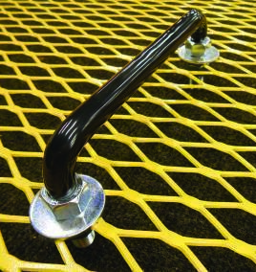
ERGONOMIC ACCESSORIES
c
c
c
GUARD HANDLES
GUARD SEATS
GUARD HANGERS
STAY AWAY – STAY SAFE

Slide 42
RECOGNITION
Is the Guard recognizable as a “Guard”?
Paint your guards a color which will stand out from your equipment.
Standardize a color which means “Danger”.
Safety Yellow is the most common color.
STAY AWAY – STAY SAFE

Slide 43
DO YOUR WORKERS KNOW?
EDUCATE YOUR WORKERS
1. How to recognize and respect when the equipment needs guarding.
2. How to recognize specific pinch points and rotating hazards in their workspace.
3. If there have been any changes to their workspace.
4. If their old/existing guarding is compliant to today’s regulations.
5. How to use the safeguarding and why it is required.
6. How and under what circumstances, can guards be safely removed and
when the guards must be replaced.
7. What they should do if a guard is damaged or missing. Who they should notify.
STAY AWAY – STAY SAFE

Slide 44
WHAT IS THE RIPPLE EFFECT?
The person who gets hurt or killed is not the only one who is affected by an accident.
c
c
STAY AWAY – STAY SAFE

Slide 45
RIPPLE EFFECT
A Workplace Injury can cause a ripple effect.
Who or what do you think is affected?
Insurance premiums are likely to rise
Employers deal with rehiring, retraining, costly fines, citations and Workers Compensation
Witnesses may develop PTSD (Post Traumatic Stress Disorder)
Colleagues have increased workload
Family & friends take on extra responsibilities
WORKPLACE
INJURY
STAY AWAY – STAY SAFE

Slide 46
ONCE YOU HAVE MADE THE DECISION TO GUARD YOUR ROTATING EQUIPMENT
- BE SURE TO GUARDSMART.
STAY AWAY – STAY SAFE

Slide 47
Our SUB - BRANDS
STAY AWAY – STAY SAFE

Slide 48
THANK YOU!

