Slide 2
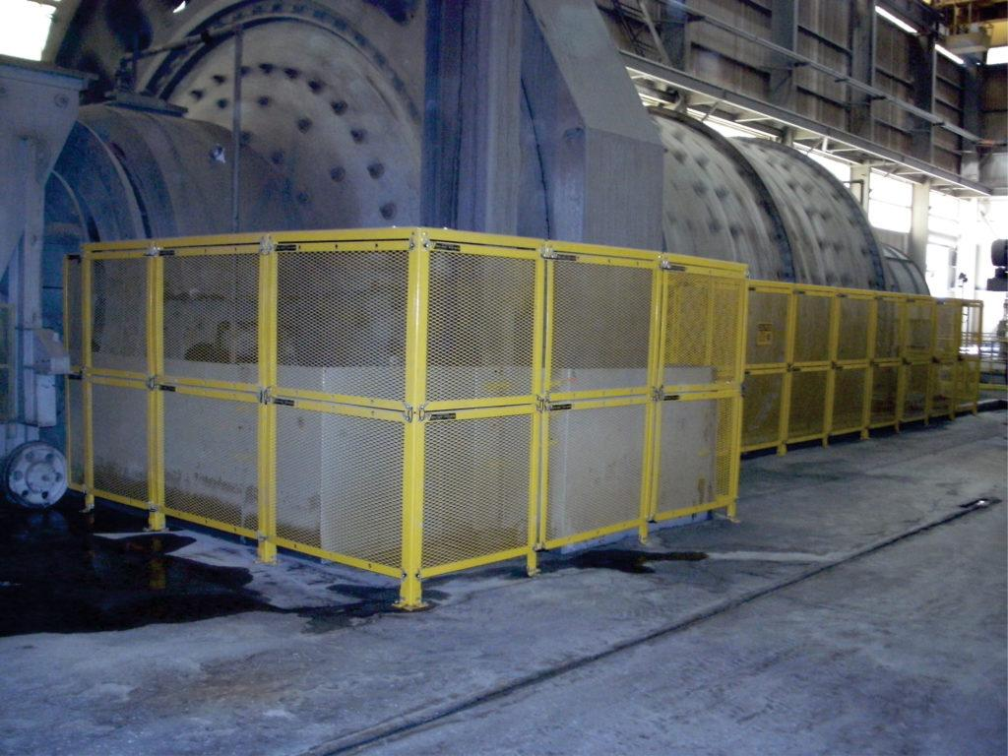
ABOUT BELT CONVEYOR GUARDING
Belt Conveyor Guarding supplies customized safety guarding products and solutions that protect workers. Our streamlined modular designs are engineered to reduce workplace injuries while improving productivity. BCG’s products are functional, affordable and ergonomic, while providing the following benefits:
Eliminating workplace injuries
Decreasing fines, citations and costly shutdowns
Improving your productivity
Ensuring compliance with OSHA, MSHA and CSA
Conforming to ANSI B11 requirements
Extending the life of your equipment

Slide 3
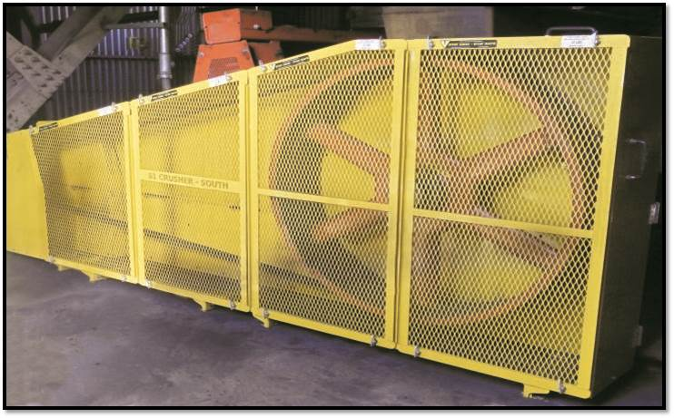
FIXED GUARDING
Fixed Guarding refers to a guard that is a physical barrier between a worker and a danger zone
and it requires a “tool to remove.”

Slide 4
WHY DO WE NEED GUARDING?
Any machine part, function, or process which may cause injury must be safeguarded. When the operation of a machine or accidental contact with it can injure the operator or others in the vicinity, the hazards must be either controlled or eliminated.
A physical barrier (fixed guarding) is a means of physically preventing access to dangerous areas.
It is a requirement by law!

Slide 5
WHAT CREATES A MECHANICAL HAZARD?
In-running nip points (pinch points)
Rotating motions/equipment
Belts or gears
Flying chips or sparks
Parts that impact or shear

Slide 6
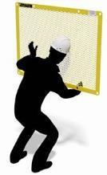
A U T O
The guarding should take into account the physical characteristics of the people involved and, in particular, their abilities to reach through openings and over or around barriers or guards.
WHEN YOU ARE GUARDING EQUIPMENT YOU MUST NOT BE ABLE TO REACH THE HAZARD FROM
Around
Under
Through
Over
c
c
c
c

Slide 7
MAINTENANCE-FRIENDLY & ERGONOMIC
It is extremely important to design your guards to be maintenance-friendly and ergonomic.
OSHA states that:
If possible, machine design should permit routine lubrication and adjustment without removal of safeguards. But when safeguards must be removed, and the machine serviced, the lockout procedure of 29 CFR 1910.147 must be adhered to.
**The maintenance and repair crew must never fail to replace the guards before the job is considered finished and the machine is released from lockout.**
If a guarding system is difficult to remove or restricts access, often routine maintenance and clean-up activities are delayed or ignored, increasing the chance of unexpected and costly breakdowns

Slide 8
IS YOUR GUARDING COSTING YOU MONEY?
When an unexpected equipment breakdown occurs, one of the first things that happen after the machine is locked out is the need to remove Safety Guards in order to access the equipment. Also, one of the last things after repair work is completed is the need to put those same guards back in place before the machinery can be powered up.
There are some questions in your checklist that should be asked:
How easy and quick are your guards to be removed and put back in place?
Does it require additional manpower?
Was additional equipment, such as forklifts or overhead lifts, required?
How much time does this add to your unexpected downtime?
What does this extra time cost you in lost production?

Slide 9
STATISTICS OF INJURIES DUE TO POOR GUARDING ERGONOMICS
The most common outcomes of poor guarding ergonomics are musculoskeletal disorders (MSDs), Repetitive Strain Injury (RSI), Cumulative Trauma Disorder (CTD) and Repetitive Motion Injury (RMI). MSD is not a medical diagnosis, it is a term used for the group of injuries, such as:
Back Pain (low back strain, etc.)
Muscle Strain
Tendonitis
Carpal Tunnel Syndrome (CTS)
Tennis Elbow
Shoulder Pains
According to ErgoPlus, MSDs account for 1/3 of all workers compensation costs in American workplaces. On average, there are 400,000 MSD injuries occur annually, which makes the direct cost to be $20 billion a year. Indirect cost (lost productivity, product defects, etc.) though, can be up to 5 times the direct cost. Finally, MSD cases require 38% more lost time days than the average injury or illness.
Notes:
https://ergo-plus.com/cost-of-musculoskeletal-disorders-infographic/
https://www.labour.gov.on.ca/english/hs/pubs/ergonomics/is_ergonomics.php

Slide 10
CALCULATE THE COST OF WORKERS’ INJURIES
Even minor injuries like back strains caused by poor ergonomics could cost far more than you may think. We used an OSHA Safety Pays calculator to estimate what would be the cost of one strain occurrence. It appears that organizations need an additional $532,407 in sales to cover the direct (direct penalty from authorities) and indirect costs (overtime, work time lost, administration, lost productivity) of a single strain due to poorly designed guards. See the next slide for detailed breakdown.
The estimate above is based off one injury to one person. The severity compared to many others injuries is minimal and yet the direct and indirect costs are significant. This is one of many reasons why ergonomics should always be considered when purchasing guards.

Slide 11
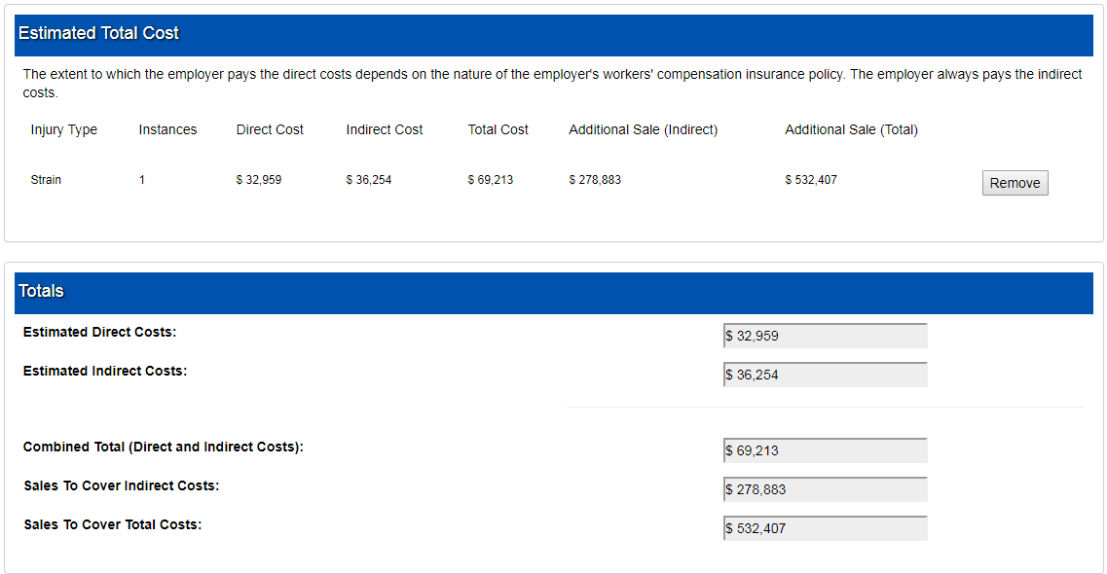
WORKER’S BACK STRAIN INJURY OUTCOMES CALCULATED

Slide 12
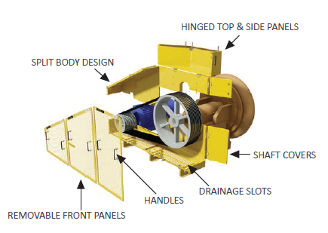
ONE-SIZE-FITS-ALL VS CUSTOMIZED SOLUTIONS
There are two general types of guarding for rotating equipment (such as V-Belts, Pumps, Couplings etc.) that is available: custom made and one-size-fits-all solutions. Very often companies prefer the second option because of its cost as well as availability in stock. However, most of the time it is not the optimal solution. See the comparison of two options on the next slide.
In summary, the initial upfront cost of customized guarding is higher, however, it will generate a substantial ROI for your organization over time!

Slide 13
ONE SIZE FITS ALL VS CUSTOMIZED SOLUTIONS
One-Size-Fits-All Solution
Custom Made Guards
Often larger than needed to be
Most require some field fitting for cut-outs
Poor or no visibility inside the guard
Time-consuming to remove the guard for maintenance
Not all rotating parts are properly covered making the guard non-compliant
Guards often not put back on because they are not user-friendly
Guards are custom designed for each application
Guards designed to fit around obstructions
Good visibility through the guard due to expanded metal and color (black mesh)
Quick removal allows for easy and fast maintenance
All rotating parts are protected ensuring compliance
Optional accessories like handles and hinges that improve ergonomics
Workers replace guards because they are user-friendly

Slide 14
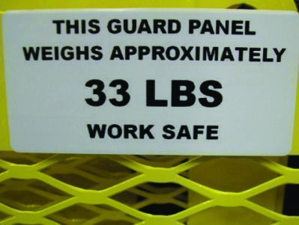
GENERAL ERGONOMICS GUIDELINES
A well designed guard should weigh less than 50 pounds.
c
A guard should not require more than one person to remove or install it.
Putting weight labels on all guards will ultimately reduce injuries.

Slide 15
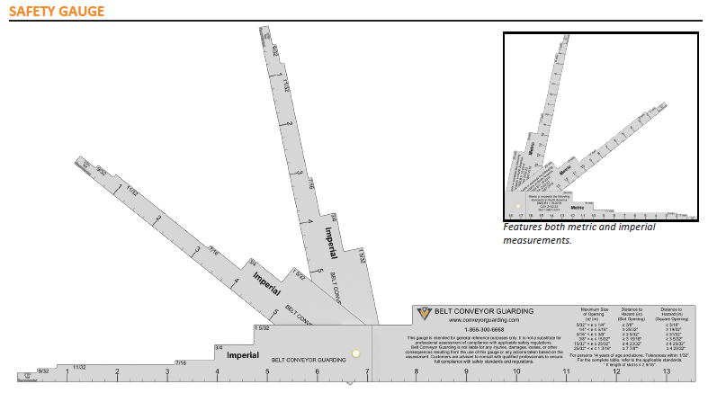
SAFETY GAUGE
The Machine Safety Gauge is a helpful tool to verify machine safety guarding compliance and ensures that workers are kept safe around rotating equipment and conveyors.
Opening size and distance requirements are outlined in
ANSI B.11.19-2019, CSA Z432:23 and ISO 13857-2019 Machine Safety and Safe Distance Standards.

Slide 16
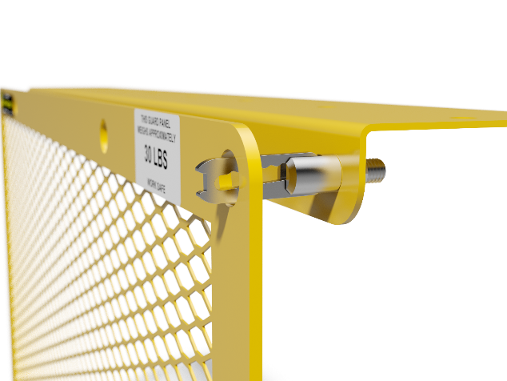
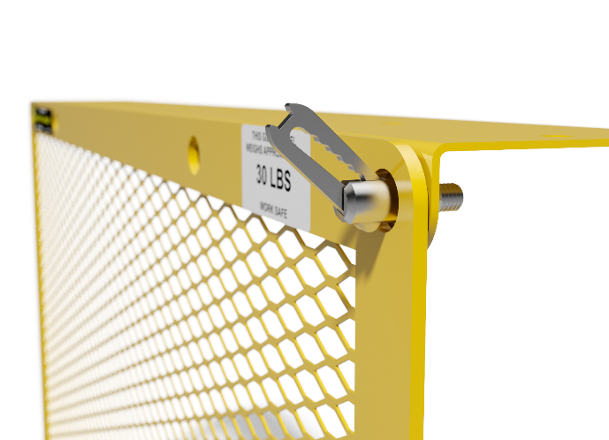
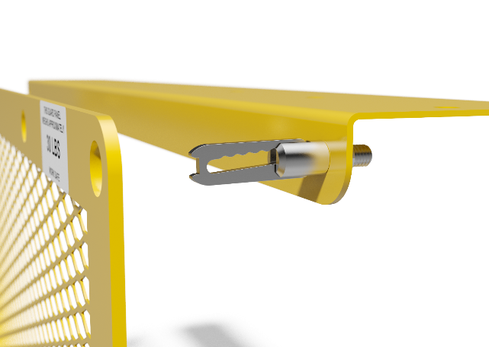
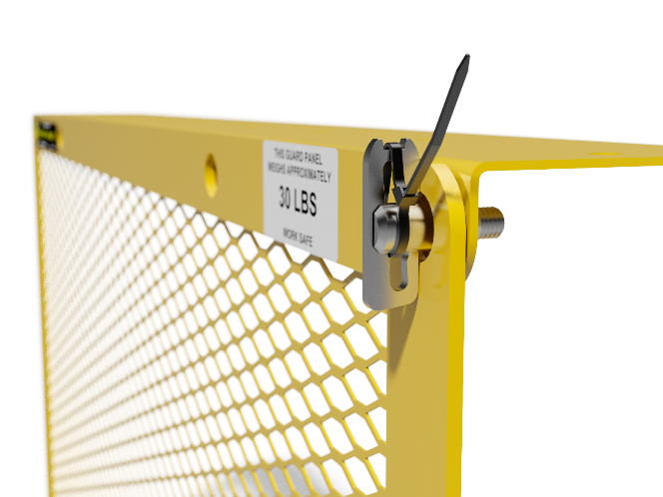
SMART WEDGE CLAMPS
The New Smart Wedge Clamp is our innovative Machine Safety Guarding Fastener that never has to be removed. It, also, allows to easily remove and reinstall safety guards as well as ensures the wedge is forced into the closed position.
FULLY OPENED POSITION
PARTIALLY OPENED POSITION
PARTIALLY CLOSED POSITION
Tie Wrap to Lock:
OSHA’s Tool to Remove
REMEMBER TO REPLACE THE TIE WRAP
PATENT PENDING

Slide 17
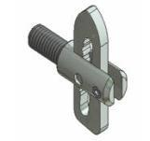
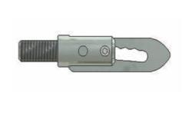
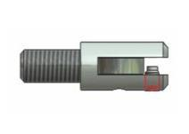
LOCKING WEDGE CLAMPS
This is designed for applications where using a cable tie is not desirable.
It requires an Allen key to quickly lock or unlock the set screw.
In open position, set screw allows installation or removal of guards
Locking Wedge Clamp body shows built in set screw
Bird’s eye view of set screw tightened, securing the guards in place
PATENTED

Slide 18
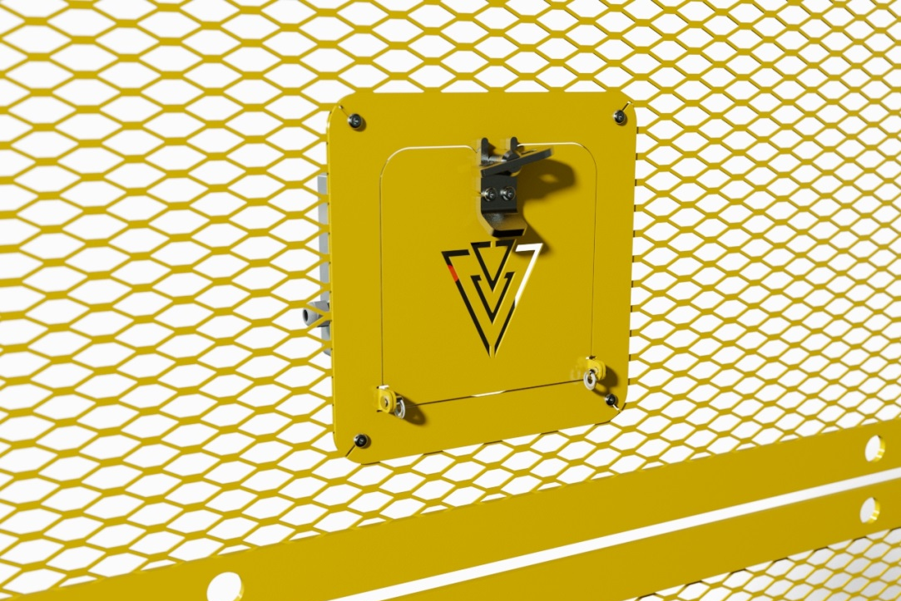
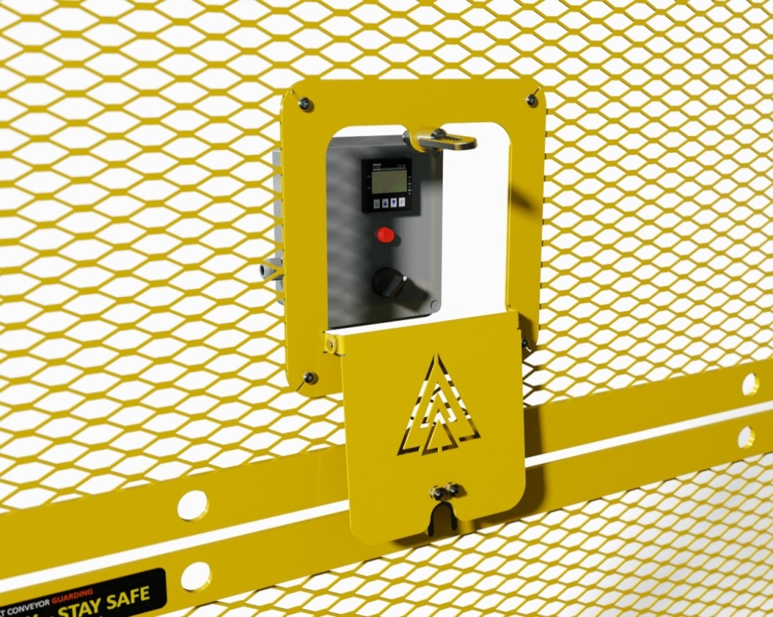
INSPECTION DOORS
Inspection Doors are necessary when you need to keep machinery running and still want to be able to inspect or access certain areas. The unique 2-piece design allows for retrofitting existing compliant guarding or installing in new.

Slide 19
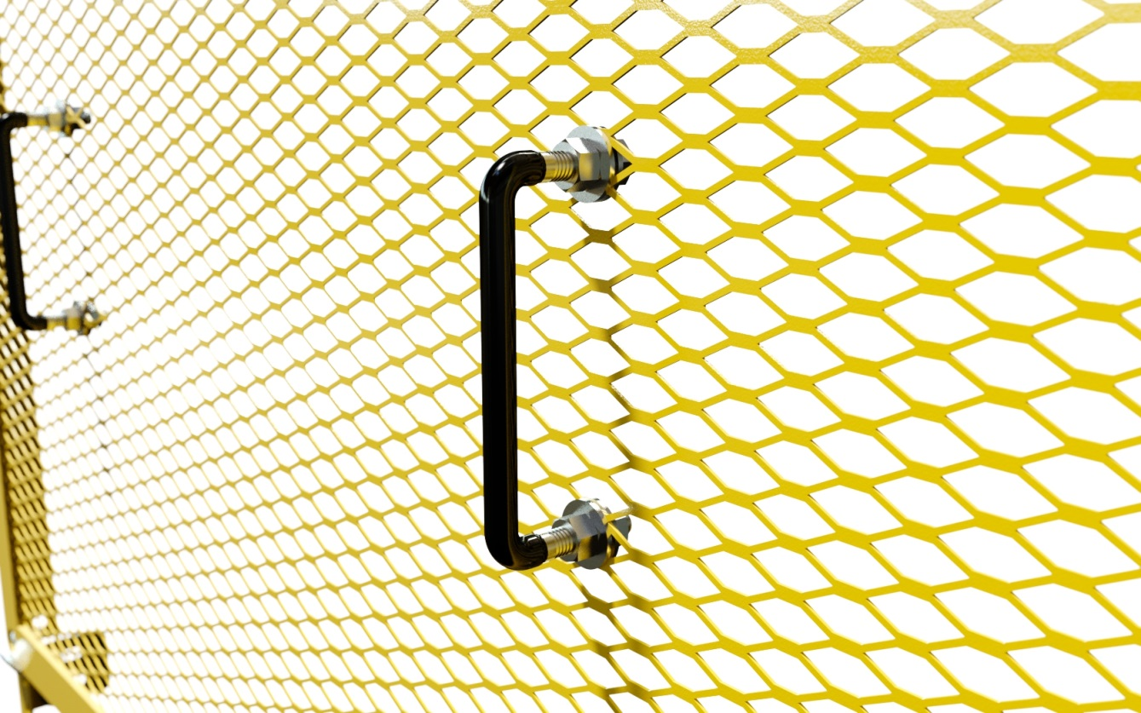
GUARD HANDLES
Guard Handles are designed to improve ergonomics of Safety Guarding and allow for easier removal and handling of guards. Furthermore, they are rubber-coated in order to add more comfort during removal or installation of a guard panel.

Slide 20
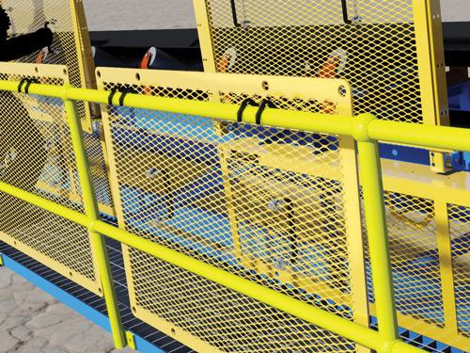
GUARD HANGERS
Guard Hangers are created in order to hang flat guard panels onto other guards or handrails during maintenance procedures. It significantly improves ergonomics as well as solves the problem of where to put your guard when removed, eliminating a potential tripping hazard.
Easy installs on flat guards
Hang guards on other flat guard panels or handrails
Can be used on both new and existing guarding
The unique non-slip design ensures a tight fit when hanging
Rubber-coated for increased friction
No negative impact on any part of your equipment due to a compact design

Slide 21
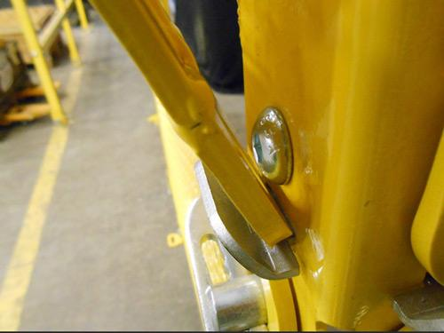
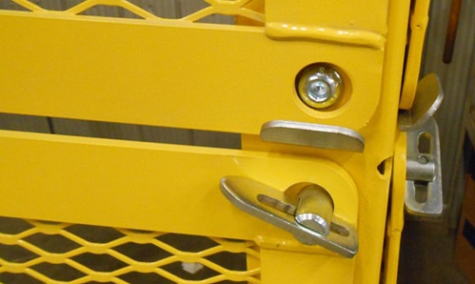
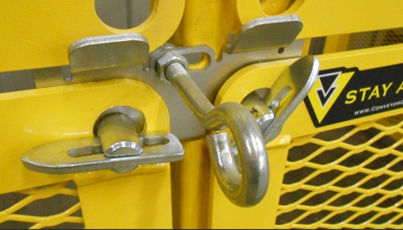
GUARD SEATS
Guard Seats securely hold the lower portion of the machine safety guard with no need for fasteners. As a result, they improve ergonomics and functionality of removing and replacing Flat Guards.

Slide 22
RIPPLE EFFECT
Insurance premiums are likely to rise
Employers deal with rehiring, retraining, costly fines, citations and Workers Compensation
Witnesses may develop PTSD (Post Traumatic Stress Disorder)
Colleagues have increased workload
Family & friends take on extra responsibilities
WORKPLACE
INJURY

Slide 23
SUMMARY
In summary, even though proper machine guarding is vital for any organization, it is also very important to make sure that guards are ergonomic and maintenance-friendly for the following reasons:
It will reduce the number of MSD injuries
The increased ROI will make up for the cost of custom guards
Faster maintenance and clean-up process
Guards will always be put back on, ensuring compliance and workers’ safety

Slide 24
ONCE YOU HAVE MADE THE DECISION TO GUARD YOUR ROTATING EQUIPMENT
- BE SURE TO GUARDSMART.

Slide 25
Our SUB-BRANDS

Slide 26
THANK YOU!

Slide 27
REFERENCES
The Cost of Musculoskeletal Disorders (MSDs) [Infographic]. (n.d.). Retrieved from https://ergo-plus.com/cost-of-musculoskeletal-disorders-infographic/
OSHA Small Business | Safety Pays Program - Estimator | Occupational Safety and Health Administration. (2015, November 16). Retrieved from https://www.osha.gov/dcsp/smallbusiness/safetypays/estimator.html

